Slide 1
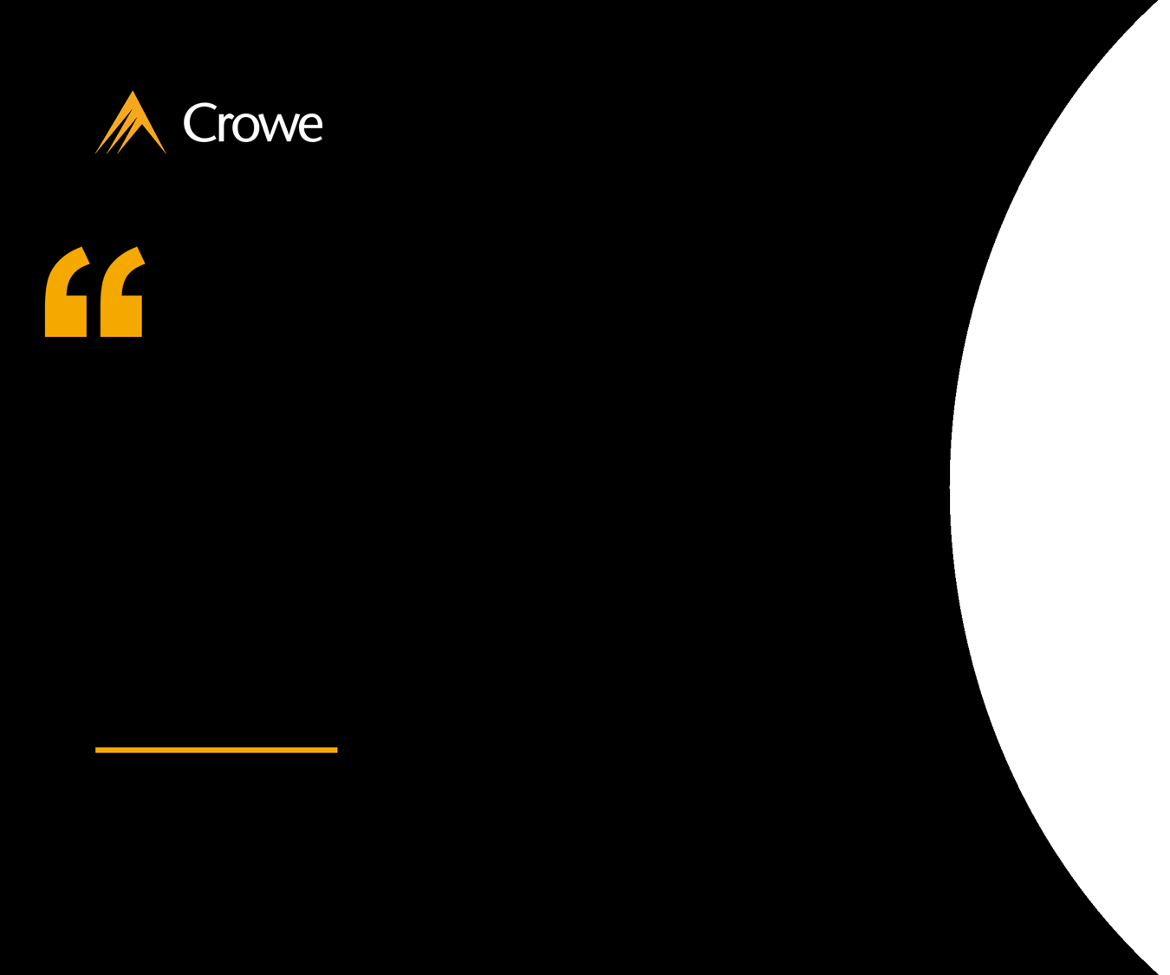
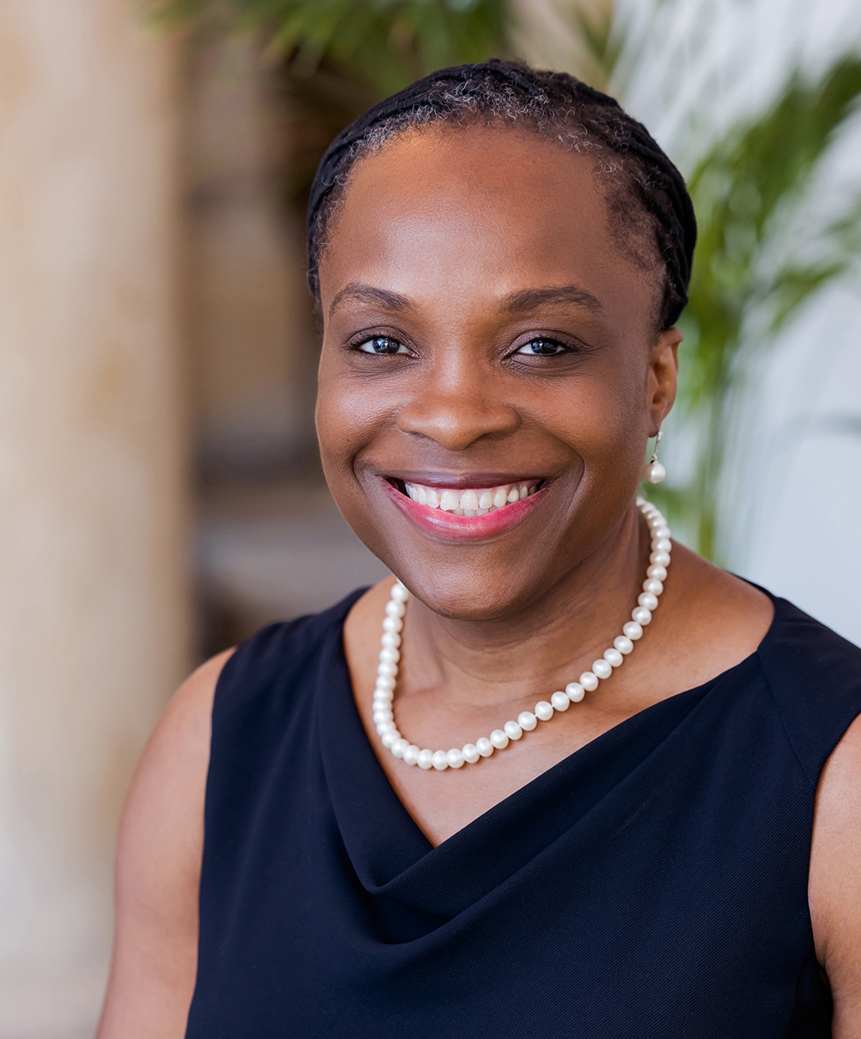
I am delighted to be joining Crowe and working with such a talented group of people. Boards and senior management must navigate a complex and evolving risk and regulatory landscape. They must be seen to respond effectively to demand from investors, campaigners, customers, and employees alike to demonstrate real progress and commitment to ESG, climate and sustainability related matters, as a core part of the delivery of their strategic outcomes.
Buki Obayiuwana
Managing Director and Head of Transformation, Risk Consulting

Slide 2
Crowe welcomes
Buki Obayiuwana
New Managing Director and Head of Transformation - Risk Consulting
Buki Obayiuwana
Managing Director and Head of Transformation, Risk Consulting

