Slide 1


Slide 2



\\\\\\\\\\\\\\\\
\\\\\\\\\\\
XX
Kirsty Rothwell
Director
Aiden Murphy
Partner
JP Kavanagh
General Manager

Slide 3
Irish Hotel Market
Kirsty Rothwell
Director, Head of Trading Assets
Cushman & Wakefield

Slide 4
Agenda
Irish Hotel Market 2018 to date
Pipeline of New Development
  - Requirement
  - Planning Analysis
  - Key Issues to Development
Conclusion

Slide 5
Hotel Transaction Activity*
€326
€291
€88
Source: Cushman & Wakefield Research
YTD Figures
*Provisional - subject to revision.

Slide 6
Hotel Transaction Activity
Value & Volume*
Source: Cushman & Wakefield Research
*Provisional - subject to revision.

Slide 7
Hotel Transaction Activity*
Source: Cushman & Wakefield Research
*Provisional - subject to revision.

Slide 8
Hotel Transaction Activity
Lot Size (%)*
Source: Cushman & Wakefield Research
*Provisional - subject to revision.

Slide 9
Hotel Sales Value by Location
2016, 2017, YTD 2018*
74%
42%
46%
Dublin
Dublin
Dublin
Outside
Dublin
26%
Outside
Dublin
58%
Outside
Dublin
54%
Source: Cushman & Wakefield Research
*Provisional - subject to revision.

Slide 10
Hotel Sales Value by Region
YTD 2018*
46%
Dublin
32%
West
19%
North East
3%
South East
Source: Cushman & Wakefield Research
*Provisional - subject to revision.

Slide 11
Hotel Sales Value by Star Rating
YTD 2017 Vs YTD 2018*
Source: Cushman & Wakefield Research
*Provisional - subject to revision.

Slide 12
Domestic Vs. International by Value
YTD Q3 2018*
73%
Foreign
27%
Domestic
Source: Cushman & Wakefield Research
*Provisional - subject to revision.

Slide 13



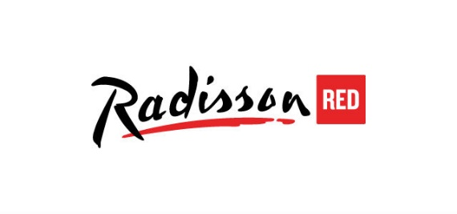






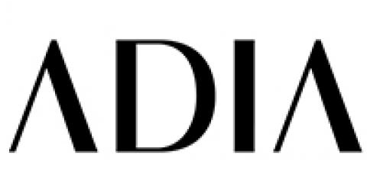







Active Purchasers

Slide 14

Top 5 Hotel Asset Transactions
YTD Q3 2018
Hotel | County | Star Rating | Price (Approx.) | Price per Room (Approx.) | Purchaser Origin | Quarter | Asset Type
Hilton Dublin Airport | Dublin | 4 | €22.5m | €135,542 | Canadian | Q3 2018 | Trading Asset
Radisson Blu Sligo | Sligo | 4 | €15m | €113,636 | Irish | Q1 2018 | Trading Asset
Ibis Hotel | Dublin | 2 | €14m | €93,333 | UK | Q3 2018 | Trading Asset
Connemara Coast Hotel | Galway | 4 | €12m | €85,106 | Austrian | Q2 2018 | Trading Asset
The McWilliam Park Hotel | Mayo | 4 | €9m | €87,379 | Austrian | Q1 2018 | Trading Asset
Source: Cushman & Wakefield Research
*Provisional - subject to revision.

Slide 15
New Development
“Dublin in line for a staggering 79 new hotels”
“Strong development ambition for new Dublin hotels”
“Dublin's hotel boom goes into overdrive”
“Dublin’s Liberties in line for economic boost”

Slide 16
Requirement for New Development
Failte Ireland
5,400 rooms to be
delivered by 2020
ITIC
11,000 beds required
by 2025
Still 1,100 short for current growth forecasts
Requirement to provide infrastructure to allow growth of up to 65% in overseas tourism revenue

Slide 17
Top 10 Hotel Completions
YTD 2018
Hotel | County | Star Rating | No. of New Rooms | Development Type | Quarter Completed
Iveagh Garden Hotel, Dublin 2 | Dublin | 4 | 145 | New Build | Q1 2018
Maldron Hotel Kevin Street, Dublin 8 | Dublin | 4 | 140 | New Build | Q2 2018
Clayton Hotel Dublin Airport | Dublin | 4 | 135 | Extension | Q2 2018
Hilton Garden Inn, Dublin 1 | Dublin | 3 | 85 | Extension | Q2 2018
The Premier Inn Hotel | Dublin | 3 | 58 | Extension | Q2 2018
Hotel 7 | Dublin | 3 | 51 | New Build | Q1 2018
Amber Springs Hotel & Health Spa | Wexford | 4 | 45 | Extension | Q1 2018
The Morgan Hotel, Dublin 1 | Dublin | 4 | 36 | Extension | Q3 2018
Trinity City Hotel, Dublin 2 | Dublin | 4 | 21 | Extension | Q2 2018
Delphi Resort | Galway | 4 | 20 | Extension | Q1 2018
Source: Cushman & Wakefield Research
*Provisional - subject to revision.

Slide 18
New Development
Full Planning List
13,005 New Rooms in the Planning System In Total
  10,890 in new hotels
  2,115 in extensions of existing properties
3,178 Rooms Under Construction
6,570 Rooms with Full Planning Permission
3,257 Applications In
  2,759 rooms in 21 new hotels
  383 rooms in extensions of 15 existing hotels
  5,660 rooms in 37 new hotels
  910 rooms in extensions of 23 existing hotels
  2,435 rooms in 30 new hotels
  822 rooms in extensions of 13 existing hotels

Slide 19
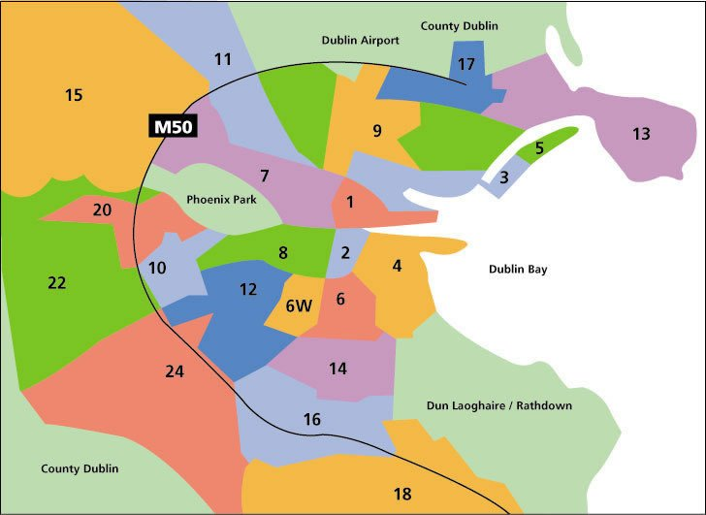
New Development
Location of Pipeline Development
Dublin 7:
Under construction: 199 rooms (6.2%)
F.P.P.: 249 rooms (3.78%)
Applications in: 28 rooms (0.08%)
Co. Dublin:
Under construction: 521 rooms (16.4%)
F.P.P.: 1,429 rooms (21.75%)
Applications in: 711 rooms (21.82%)
Dublin 13:
Under construction: 0 rooms
Full planning permission: 229rooms (3.4%)
Applications in: 0 rooms
Dublin 11:
Under construction: 0 rooms
Full planning permission: 0 rooms
Applications in: 100 rooms (3%)
Dublin 1:
Under construction: 494 rooms (15.5%)
Full planning permission: 2,139 rooms (32.5%)
Applications in: 768 rooms (23.6%)
Dublin 15:
Under construction: 0 rooms
Full planning permission: 0 rooms
Applications in: 168 rooms (5.15%)
Dublin 2:
Under construction: 1,258 rooms (39.6%)
Full planning permission: 1,485 rooms (22.6%)
Applications in: 891 rooms (27.4%)
Dublin 20:
Under construction: 0 rooms
Full planning permission: 0 rooms
Applications in: 220 rooms (6.75%)
Dublin 4:
Under construction: 38 rooms (1.1%)
Full planning permission: 223 rooms (3.3%)
Applications in: 20 rooms (0.06%)
Dublin 22:
Under construction: 44 rooms(1.38%)
Full planning permission: 0 rooms
Applications in: 78 rooms (2.39%)
Dublin 24:
Under construction: 0 rooms
Full planning permission: 89 rooms (1.35%)
Applications in: 119 rooms (3.6%
Dublin 8:
Under construction: 605 rooms (19%)
Full planning permission: 687 rooms (10.4%)
Applications in: 44 rooms (1.3%)
Dublin 14:
Under construction: 0 rooms
F.P.P.: 0 rooms
Applications in: 39 rooms (1.2%)
Dublin 6:
Under construction: 41 rooms (1.2%)
Full planning permission: 40 rooms (0.06%)
Applications in: 71 rooms (2.1%)

Slide 20


New Development
Key Issues Affecting Development
Funding
Alternative Uses

Slide 21
Keep Building

Slide 22
Thank you

Slide 23
Irish Hotel Market Briefing
Aiden Murphy
Partner, Crowe

Slide 24

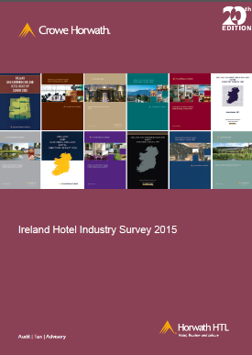


Crowe Ireland Annual Hotel Industry Survey

Slide 25
Future Direction of Ireland’s Hotel Market
What are the repercussions of a slow down or decrease in profit?
How might new supply impact hotel profits?
With the new market dynamics would hotels be able to pass on any increase in VAT rate?

Slide 26
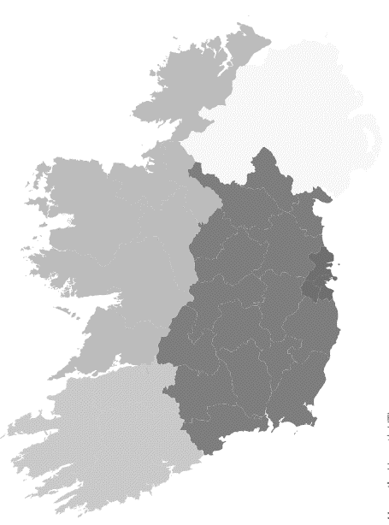
Overview of Ireland Hotel Supply - 2018
58,757
Rooms
820
Hotels

Slide 27
Dublin KPIs
 | 2015 | 2016 | 2017
ARR | €112 | €128 | €137
Occupancy | 80.7% | 82.3% | 83.5%
RevPAR | €90 | €106 | €114
Revenue | €59.1k | €66.9k | €72.9k
YOY Growth % |  | 13% | 9%
EBITDAR | €16.9k | €20.4k | €22.9k
YOY Growth % |  | 21% | 12%
EBITDAR % | 28.6% | 30.7% | 31.4%
Payroll Cost % | 32.5% | 30.0% | 30.1%

Slide 28
Regional Ireland KPIs
 | 2015 | 2016 | 2017
ARR | €81 | €88 | €95
Occupancy | 66.2% | 68.6% | 70.7%
RevPAR | €54 | €60 | €67
Revenue | €58.7k | €64.5k | €69.9k
YOY Growth % |  | 10% | 8%
EBITDAR | €9.0k | €10.5k | €12.2k
YOY Growth % |  | 17% | 16%
EBITDAR % | 15.4% | 16.5% | 17.8%
Payroll Cost % | 37.8% | 37.0% | 36.9%

Slide 29

Risk Areas
£
Social Housing
& Student Accommodation
Global
Economy
New
Supply
Brexit
Airbnb

Slide 30
Ireland’s Economic Conditions
The fastest growing economy in EU
The fastest growing
economy in EU
2018(F) of 9% for Ireland

Slide 31
Dublin Occupancy 2017 v Other European Cities
Source: STR Global Data

Slide 32
New Supply Dublin: Hotels & Aparthotels
Hotels: Extra 1.8m rooms to sell
Aparthotels: Extra 2.2m rooms to sell
+6,000 Rooms
2018
2019
2020

Slide 33
How many room nights do we have to sell in Dublin?
2017
Supply
19,381
Occupancy
83.5%
Rooms Sold
5.9m
2020
Supply
24,308
Occupancy
80.7%
Rooms Sold
7.2m
2020
Occupancy
83.5%
Rooms Sold
7.4m
Supply
24,308

Slide 34
How might new supply impact EBITDAR?
2017
Occupancy | 83.5%
ADR | €137
Revenue
Rooms | €41.3k | 57%
F&B & Other | €31.4k | 43%
Total Revenue | €72.9k
Dept. Profit | €42.0k | 58%
EBITDAR | €22.9k | 31%
Scenario 1
Occupancy | 80.7%
ADR | €112
Revenue
Rooms | €33.0k | 52%
F&B & Other | €30.7k | 48%
Total Revenue | €63.7k
Dept. Profit | €34.1k | 54%
EBITDAR | €17.2k | 27%
-€5.8k EBITDAR
-25%

Slide 35
Occupancy increased from 80.7% to 83.5% (2015 - 2017)
Off-Peak Months
2015 | 2017
€103 | €123
72% | 76%
Peak Months
2015 | 2017
€120 | €151
89% | 91%

Slide 36
How might new supply impact EBITDAR?
2017
Occupancy | 83.5%
ADR | €137
Revenue
Rooms | €41.3k | 57%
F&B & Other | €31.4k | 43%
Total Revenue | €72.9k
Dept. Profit | €42.0k | 58%
EBITDAR | €22.9k | 31%
Scenario 2
Occupancy | 80.7%
ADR | €132
Revenue
Rooms | €38.9k | 56%
F&B & Other | €30.7k | 44%
Total Revenue | €69.6k
Dept. Profit | €38.8k | 56%
EBITDAR | €20.3k | 29%
-€2.7k EBITDAR
-12%

Slide 37
How might new supply impact EBITDAR?
2017
Occupancy | 83.5%
ADR | €137
Revenue
Rooms | €41.3k | 57%
F&B & Other | €31.4k | 43%
Total Revenue | €72.9k
Dept. Profit | €42.0k | 58%
EBITDAR | €22.9k | 31%
Scenario 3
Occupancy | 80.7%
ADR | €137
Revenue
Rooms | €40.4k | 57%
F&B & Other | €30.7k | 43%
Total Revenue | €71.1k
Dept. Profit | €40.5k | 57%
EBITDAR | €21.6k | 30%
-€1.4k EBITDAR
-6%

Slide 38
Projected Increase in Hotel Supply
By Grade:
+5%
+30%
+30%
By Location:
+25%
+35%
+5%
Airport
City Centre
Other Dublin

Slide 39








Tourism Demand
 | 2017 | 2025 | Growth
International Visitors to Ireland | 8.9m | 13.7m | +54%
Value of Sector | €4.9bn | €8.1bn | +65%
Source: ITIC & Fáilte Ireland

Slide 40
VAT Rate

Slide 41
Future Direction of Ireland’s Hotel Market
What are the repercussions of a slow down or decrease in profit?
How might new supply impact hotel profits?
With the new market dynamics would hotels be able to pass on any increase in VAT rate?

Slide 42
5 Year Outlook - Dublin
Forecast | 2011-2017 | 2018 | 2019 | 2020 | 2021 | 2022
Occupancy
ARR
Profit
Concentration of new supply delivery over a short period, results in concern on sustaining profits

Slide 43
5 Year Outlook – Regional Ireland
Forecast | 2011-2017 | 2018 | 2019 | 2020 | 2021 | 2022
Occupancy
ARR
Profit
Challenge for profitability growth is hotels’ ability to grow revenues at higher levels than the cost increases

Slide 44

Thank you
Aiden Murphy
Partner
aiden.murphy@crowe.ie

Slide 45
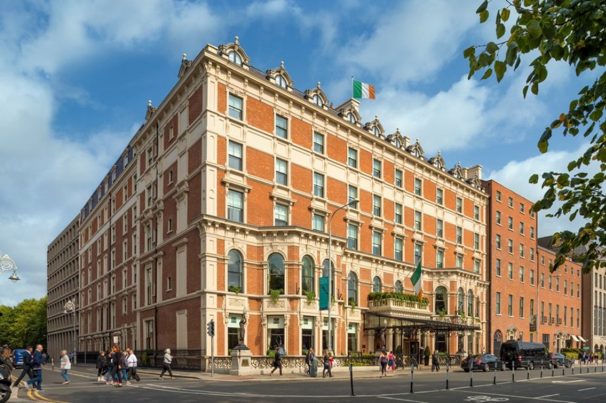
JP Kavanagh
General Manager
The Shelbourne

