Slide 1
Doing Business in Bolivia
Tax System
Roberto Viscafé Ureña
September 30, 2019

Slide 2
Doing Business in Bolivia

Slide 3
Some Information
Fuente: https://www.doingbusiness.org/content/dam/doingBusiness/country/b/bolivia/BOL.pdf
City | Starting a Business in Bolivia Ranking 1-190
Chile | 72
Argentina | 128
Brazil | 140
Ecuador | 168
Bolivia | 178

Slide 4
Some Information
Fuente: https://www.doingbusiness.org/content/dam/doingBusiness/country/b/bolivia/BOL.pdf
City | Ease of doing Business Bolivia Ranking 1-190
Chile | 56
Argentina | 119
Brazil | 109
Ecuador | 123
Bolivia | 156

Slide 5
Tax incentives on investment
There are no local government's restrictive regulations on foreign investments.
Bolivia has the following tax incentives on profits:
        Investments in the city of El Alto are exempt of the IUE for 10 years.
        Companies dedicated to tourism activities, established in the city of Sucre, has the exemption of the IUE for 10 years.
        Exemption for 10 years of payment: national, departmental, municipal, and university taxes to all of the manufacturing industries established on the cities of Oruro and Potosi.
        deferred payment on the Value Added Tax (VAT) payment and Customs Liens on entrance of capital goods of up to 36 months with the previous payment of 10%.

Slide 6











DDT Bolivia
COLOMBIA
ECUADOR
BOLIVIA
PERÚ
Comunidad Andina de Naciones
ALEMANIA
SUECIA
FRANCIA
ARGENTINA
REINO UNIDO
ESPAÑA
The application of International Agreements to avoid double taxation in regards of Income Tax.

Slide 7
Bolivian Tax System
Impuesto al Valor Agregado (IVA)
Régimen Complementario al Impuesto al Valor Agregado (RC-IVA)
Impuesto sobre las Utilidades de las Empresas (IUE)
Precios de Transferencia
Impuesto Directo a los Hidrcarburos (IDH)
Alícuota Adicional a las Utilidades por Extracciones Extraordinarias de Recursos No Renovables.
  Mineria 12,5% + Surtax 25%
Financiero 25%

Slide 8
Bolivian Tax System
Impuesto a la propiedad de Bienes Inmuebles y Vehículos Automotores
Impuesto a las Transacciones (IT)
Impuesto a los Consumos Específicos (ICE)
Impuesto al Juego
Impuesto a las salidas al Exterior
Impuesto a las Transferencias Financieras (ITF)
Impuesto Especifico a los Hidrocarburos y Derivados (IEHD).

Slide 9
Tax System

Slide 10
Tax System
Corporate Tax
        Value Added Tax 14.94
        Transaction Tax (3%) Included VAT
        Income Tax (25%) Minning 37.5. Financial (50%)
        Withholding Tax 12.5%
Personal Tax
        Value Added Tax Complementary Regime 13%

Slide 11
Corporate Tax

Slide 12
Value Added Tax (IVA)
This Tax Affects Sales Of:
        Fixtures,
        Service-rendering,
        Contracts,
        Jobs performed in Bolivia,
        Definite imports.

Slide 13
Value Added Tax (IVA)
The Following Are Not Included In The Taxable Subject:
        Interest on granted loans and received deposits from financial institutions.
        Sales-purchases of stocks, debentures, securities and financial claims.
        Transferences of company’s reorganization,
        Capital Contributions.

Slide 14
Value Added Tax (IVA)
The Following Are Exempt Of This Tax:
      Imported goods by diplomatic representations.
      Admissions “bonafide” of goods with a limit of US$ 1.000
      Life insurance premiums.
      Capital earnings
      Artistic events of national folklore.

Slide 15
Value Added Tax (IVA)
Tax Rate
        Nominal tax rate is 13%,
        Effective tax a 14,94%,
        The tax must not be shown separately on the invoice.
Tax Liquidation
Monthly, the payable tax is the difference of debit (sales), minus credit (purchases).

Slide 16
Value Added Tax (IVA)
Importation Tax Liquidation
The liquidation must be applied at the moment of performing the customs dispatch, either the definite dispatch or the emergency one.
The tax base is given by the Customs-CIF
In case of imports of capital goods, the VAT payment, as well as the GA, can be certified within a 36-month term, with a previous payment of a 10% of such amounts.

Slide 17
Transaction Tax (IT)
This tax affects the exercise of trade, industry, profession, craft, business, rent of goods, jobs or services, transferences of holdings on onerous title and/or free of fixtures, real state and rights and/or any other commercial activity, either for profit or not, performed within the Bolivian soil.
All the corporate income.

Slide 18
Transaction Tax (IT)
Transferences Which Are Not Included In The Tax Subject Are:
        Company reorganization processes, understanding as such cleavage, merges, and/or legal modification of a company.
        Capital contributions.
        Non current sales of vehicles and real state which are taxed by the Municipal Tax on Real State and Vehicle Transferences.

Slide 19
Transaction Tax (IT)
The Following Are Exempt From This Tax:
        Labor of personnel within a dependency relationship
        Performance of public positions.
        Exports.
        Sales/purchase of minerals, metals, oil and natural gas on the internal market, as long as its final destination is exporting them.
        Services of diplomatic missions and foreign international bodies.

Slide 20
Transaction Tax (IT)
Tax Rate
Tax rate of this tax is 3%, which is applicable on the gross accrued income.
Tax Liquidation
Monthly, days 13 and 22 of the following month from the fiscal period which is being liquidated, based on the last digit of the NIT (Tributary Number Identification)
The payable tax is created from 3% of gross accrued income.
Compensation Of Tax
The Corporate Income Tax (IUE), effectively paid, is considered as an advance payment of this tax.

Slide 21
Company Income Tax (IUE)
This tax affects profits from Bolivian source earned by companies with an address in Bolivia.
Bolivian-source profits are those that are generated from goods located, allocated, or economically utilized in Bolivia; by realizing any act or activity susceptible of generating profits in Bolivian soil; or deeds which happen inside the border, without taking into account the nationality, residence address or the bearer.

Slide 22
Company Income Tax (IUE)
The Following Are Not Included In The Tax Subject:
        Results which are a consequence of a process of the company’s reorganization, understanding as such the cleavage, merge, legal modification of a company and/or capital contributions.
        Benefits gained as profit distribution, whenever the distributing company is passive subject of this tax.
        Income and/or rent from foreign source.

Slide 23
Company Income Tax (IUE)
The Following are Exempt From This Tax:
        The State’s activities and its departments..
        Profits gained from associations, foundations, or non-for-profit institutions legally authorized, such as churches, charity, relief, social welfare, educational, cultural, scientific, ecologic, artistic, literature, sports, political, professional, and unions, in case this institutions do not perform financial intermediation activities or other trade activities.
        Interest in behalf of international credit organizations and official foreign institutions.
        Life insurance primes.

Slide 24
Company Income Tax (IUE)
Tax Liquidation
The due dates of this tax are established according to the type of activity that the Company performs. Due dates are established as follows:
Deadline | Company’s Activity
March 31 | Industrial, oil and construction.
June 30 | Rubber, chestnuts, agricultural, cattle, and agro industry.
September 30 | Mining.
December 31 | Banking, insurance, trade, services, person performing professions or tasks and others not covered by the previous groups.

Slide 25
Company Income Tax (IUE)
Tax Base
Tax base for companies is generated from financial statements at the year end closing date.
Tax Rate
Tax rate for this tax is 25% of the tax base.
Mining 12,5% + Surtax 25%
Financial Institutions 25%
Compensation for losses do not have a term in time, except in cases of company’s merges, in which case the compensation has a term of the 4th year.

Slide 26
Withholding (IUE-BE) 12.5%
Our legislation is based on the principle of source and territoriality for the application of Income Tax, and despite they are not paid in Bolivia, they are still considered as rents from Bolivian source. Some of them are:
        Wages or salaries that board members, counsel or directory bodies receive as a result of activities performed abroad for companies residing in Bolivia.
        Salaries, retributions or wages as a result of service rendering of: consultancy, advisory of any kind, technical assistance, research, professional services and expert testimony, performed from or abroad.
When companies pay these type of rent, they must withhold a tax rate of 12.5% on the consigned amount.

Slide 27
Withholding (IUE-BE) 12.5%
In case of Branch offices of companies abroad, it is assumed without accepting counter-evidences, that the profit distribution was performed on the due date of the Income Tax, independently of the effective pay-date, except the re-investment amount.

Slide 28
Tax on Mining
It taxes, exploration, exploitation, concentration, ironworks, refining, and mineral and metal trade in Bolivian territory.
Mineral and metal manufacturing is not in the object of this tax.
The tax base is perfected: In case of internal market sales, when an invoice or receipt and/or equivalent document. In case of export in the provisional and/or definite liquidation of the export process.
Tax Rate
The tax rate is given by the percent rates differentiated by quotation and by product, depending on the mineral or metal, according a scale.
Mining 12,5% + Surtax 25%

Slide 29
Specific Consumption Tax (ICE)
It taxes the production and the imports of some goods.
Tax Rate
It is differenced by the type of product. Furthermore there are specific rates by measuring unit and percent rates.

Slide 30
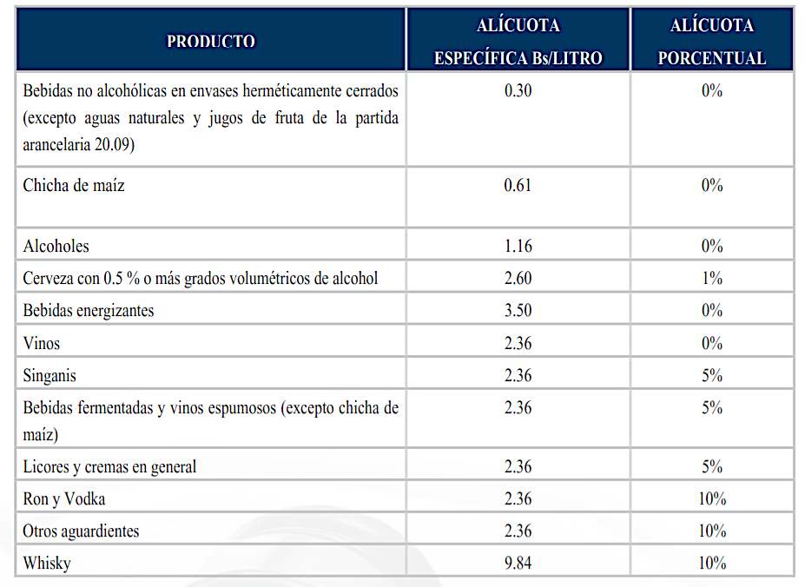
Specific Consumption Tax (ICE)

Slide 31
Hydrocarbon Direct Tax
It taxes trade, at its first stage, in the hydrocarbon and derived products internal market, and import of those products.
It is understood as internally produced or imported, those hydrocarbons and derived products obtained any production, refining, mixture, adding, separation, recycling, customization, process units (platforming, isomerización, cracking, blending or any other name) or any other way of conditioning for transportation, use, or consumption.

Slide 32
Financial Transactions Tax (ITF)
  The operations that are taxed are:
  • Retirements and deposits made in Loan Accounts that has no exempts more than USD 2.000
  • Payments or transferences of found to an institution ruled by the Banks and Financial Entities law (for instance credits payment).
  • Purchase of management checks, travelers checks and other and similar, existent or to create financial instruments.
  • The payment of basic services and other collection services (even effective payments). This tax is paid by the collection service contractor entity; not for the user that pays for the service.
  • Credit transfers or drafts money made inside the country.

Slide 33
Tax on Casual Transferences of Vehicles and Real State
It taxes the casual real state and vehicles transferences held in Bolivia, the tax rate is 3%.
In regards to this tax, the following is considered:
        • Eventual sales of taxed goods transference, when they are already registered in the Real State Rights Office or Municipal records; (because is not the first sale) otherwise, it is considered as a current sale, and the operation is taxed by the Transaction Tax (IT).
        • Changeover is considered as a double operation.

Slide 34
Tax on Hereditary and Free Transfer of Goods (ITGB)
It taxes the heredity successions and legal acts by which property is freely transferred. Only real state, stocks, capital allocations and other goods subject to register are in the range of this object.
Tax Rate
        Ascendant, descendant and/or spouse, 1%
        Brothers and their descendants, 10%
        Others, legatees and free appointees, 20%

Slide 35
Tax on Abroad Airborne Exit (ISAE)
It taxes the abroad airborne exits. Passive agents are natural persons who reside in Bolivia and travel abroad.
The tax rate is a fix amount, equivalent in every case to almost US$ 55. Tax liquidation is paid at the moment of boarding the plane.

Slide 36
Taxes On Natural Persons

Slide 37
Personal Income Tax (RC-IVA)
The main subject of this tax is to tax income from persons that work within a dependency relationship.
RC-IVA can be compensated with VAT paid by employees when the perform all purchases of goods and/or services, with the condition that purchases must be documented with invoices.
The company has the responsibility of acting as a withholding agent; meaning that it is responsible of depositing the RC-IVA to the Tax Administration office coming from paid wages to their employees, who must be included in the payroll.

Slide 38
Personal Income Tax (RC-IVA)
Besides Salaries, The Following Are Also Taxed:
        Premiums,
        Bonuses,
        Gratuity,
        Compensations
        Assignments of any nature in cash or kind.

Slide 39
Personal Income Tax (RC-IVA)
Besides Salaries, The Following Are Not Taxed:
Traveling and representation expenses that are duly backed up by invoices, from foreign or local origin, whenever they are related to the activity of the company and in case there is a balance that is refunded
        Christmas Bonus.
        Social benefits of indemnities and evictions, drawn according to current legal arrangements on the matter.
        Pre-family, wedding, birth, lactation, family and burial allowances received according to the Social Security Code.

Slide 40
Personal Income Tax (RC-IVA)
Tax Rate
Tax rate is 13% on the total earned amount, minus short and long term social security rates.
Tax Liquidation
Monthly, days 13 and 22 of the following month from the fiscal period which is being liquidated, based on the last digit of the NIT (Tributary Number Identification)

Slide 41
Roberto Viscafé Ureña
roberto.viscafe@crowe.com.bo
International Liaison Partner

