Slide 1

Webinar
Blockchain, crypto assets
and their markets:
A challenge
or opportunity
for banks?
July 2021
Webinar | ABA

Slide 2
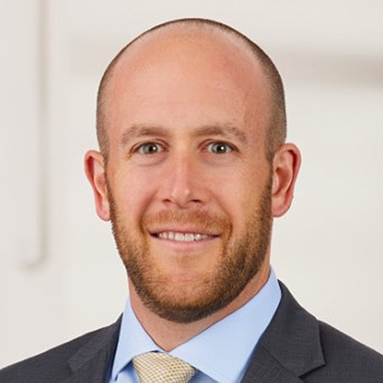
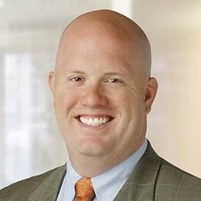


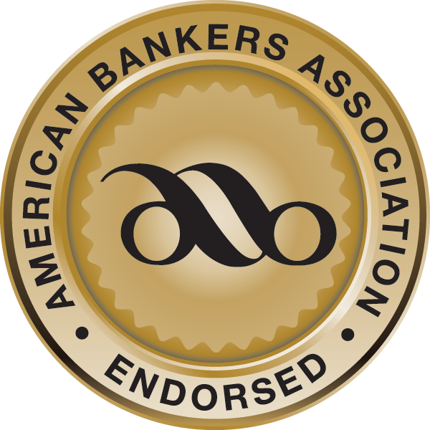
Presenters
Blockchain, Crypto Assets and Their Markets:
A Challenge or Opportunity for Banks?
Thomas Lazard
Matthew Schell
Justin Steffen
Robert Morgan
Principal
Crowe Financial
Services Consulting
Partner
Crowe Accounting
National Office
Partner
Barack Ferrazzano Kirschbaum & Nagelberg LLP
Senior Vice President
ABA Office of Innovation

Slide 3





Finding where crypto can take you
starts with understanding the basics.
Distributed
Ledger
Technology
Blockchain
Digital
Assets
Crypto
Assets
Stablecoin

Slide 4
Looking for stability
Setting the right course means
knowing the key players.
Exchanges
Merchant Services/
Clearing and Settlements
Custody
Decentralized Finance
Coinbase
Kraken
OCC Trust
Lending
BitPay
Paxos
Anchorage Digital Bank
Paxos National Trust
Compound
Aave
Gemini
Bitstamp
Coinify
Coinbase
Commerce
Protego Trust Bank
BitPay National Trust Bank
(application filed)
Maker
Paxos
BlockFi
BitGo
CMT Digital
Wallets
Wyoming SPDI Banks
DEX
Xapo
Ledger
Avanti
Kraken
Uniswap
Sushiswap
Trezor
Fireblocks
Curve.fi
New York Bitlicense
Copper
MyEther
Wallet.com
Coinbase Custody
NYDIG

Slide 5
Staying relevant
Worlds are colliding into a shared space.
But there’s room for you.
Typical Applications
Payments/Settlements
Custody/Wealth management
Lending/Collateral perfection
Merchant processing
Crypto ATMs
Stablecoins
Crypto rewards
DeFi (including lending, staking, etc.)
Investment vehicles sponsor
Banks
Fintech

Slide 6
Working within legislation
Emerging regulations could open one door
while closing another.
State laws in the making
Blockchain and Distributed Ledger Laws in a map of the states, denoted by one of five colors:
Favorable - Generally
Mixed - Favorable and restrictive
Restrictive - Somewhat
Restrictive - Generally
Neutral - Largely Silent
Federal agencies / SROs
Commodity Futures Trading Commission
U.S. Securities and Exchange Commission
Internal Revenue Service
Financial Industry Regulatory Authority
National Futures Association
Office of the Comptroller of the Currency
Federal Deposit Insurance Corporation
Federal Reserve Board
U.S. Department of the Treasury

Slide 7
Strategically assess and respond to market changes
Strategic planning can show your next move,
while also mitigating risk.
STEP 1
Identify areas of need
Privacy
Cybersecurity
Financial Crime
Third-Party Risk
Regulatory & Compliance
Enterprise Risk Management
Credit & Credit Administration
Model Risk Management
Data Governance
Internal Audit
Financial
Legal
STEP 2
Understand risk
STEP 3
Assess inherent risk
STEP 4
Assess control environment
Understand your risk universe
Determine risk applicability
Identify risk appetite
Identify
Measure
Evaluate
Evaluate current state controls
Evaluate control needs and conceptual planning

Slide 8









A sustainable process
Build your solutions once you identify them.
STEP 5
Informed Decision & Plan
Development
Determine cost
Make an informed decision
Enhance control environment
Program Development and Documentation
Vendor System Implementation
Training
Operational
System Optimization and Calibration
Analytical Context and Performance
Customer Transaction Processing
Sustainable
Risk Assessment and Remediation
Independent Testing
/ Audit Services
Model & System Validation

Slide 9
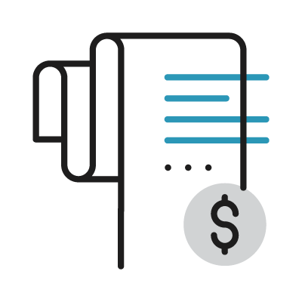
Finding your path forward can be challenging
Are digital assets a threat …
or an opportunity?
Is there a future for you in digital assets?
How will your regulations and
reporting change?
Customer loss
Regulatory uncertainty
Considerations for evolving regulatory guidance
Building consistent low-cost revenue streams
Growth through expanded offerings or deepened customer relationships
Building your brand
or
Will you be able
to keep up with
customer demands?
Growth through expanded offerings
Consistent low-cost revenue streams
What are your
avenues for growth?

Slide 10
We can help you understand
the current digital assets landscape.
Thomas Lazard
Matthew Schell
Principal
Crowe Financial
Services Consulting
thomas.lazard@crowe.com
Partner
Crowe Accounting
National Office
matthew.schell@crowe.com

Slide 11
Thank you.
Smart decisions. Lasting value.TM
Learn more at crowe.com

